Slide 1

School of Electrical Engineering and Computer Science
Department of Electrical Engineering
EE-371 : Control Systems
Lecture#22
Steady-State Error for Unity Feedback Systems
Textbook: Chapter # 07 (5th edition)
Text Book: Control Systems Engineering by Norman S. Nise 5th Edition
Instructor: Ms Neelma Naz
Class: BEE 12 C/D

Slide 2
Introduction
Control systems analysis and design focus on three specifications:
transient response
stability
steady-state errors

Slide 3
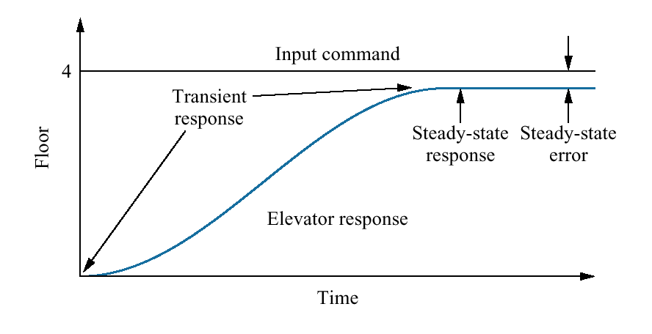
Figure1.5
Elevator input and output

Slide 4
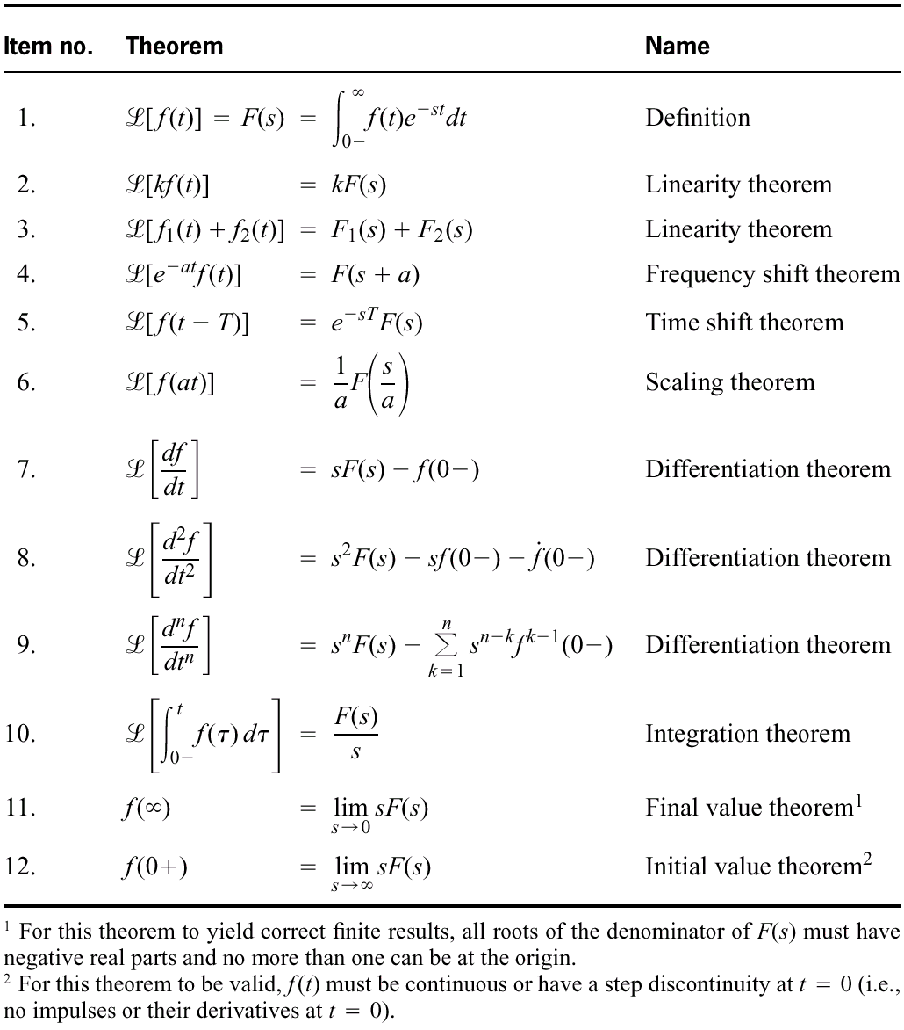
Laplace
transform theorems

Slide 5
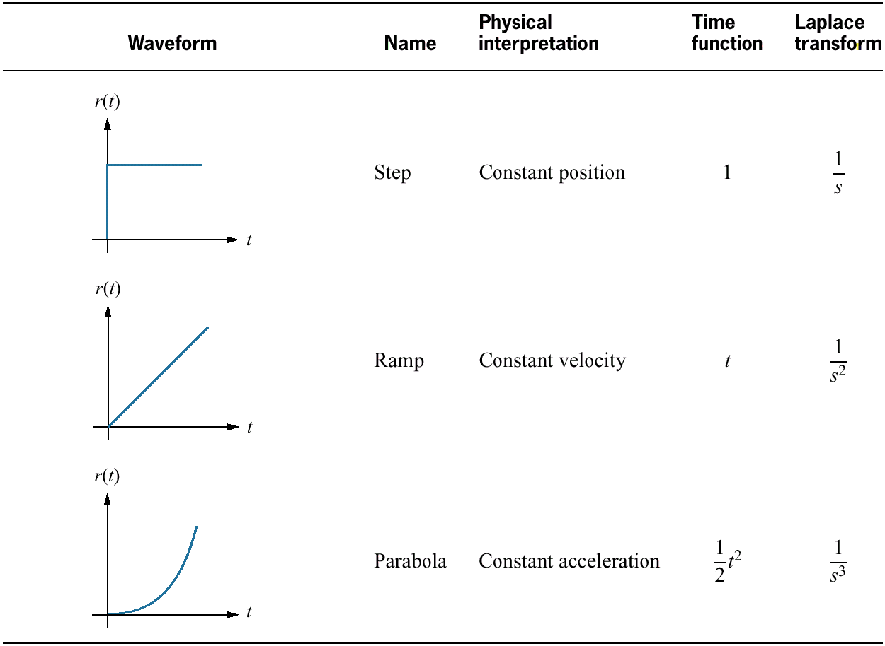
Table 7.1
Test waveforms for evaluating steady-state errors of position control systems

Slide 6
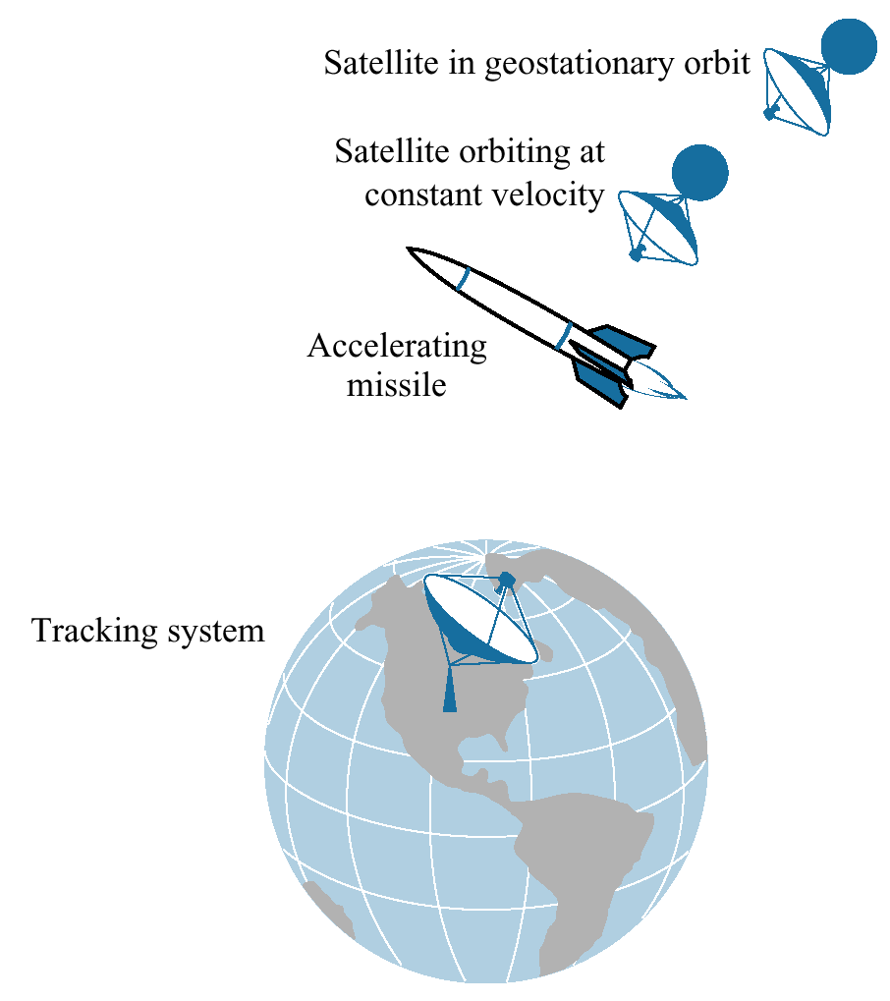
Figure 7.1
Test inputs for steady-state error analysis and design vary with target type

Slide 7
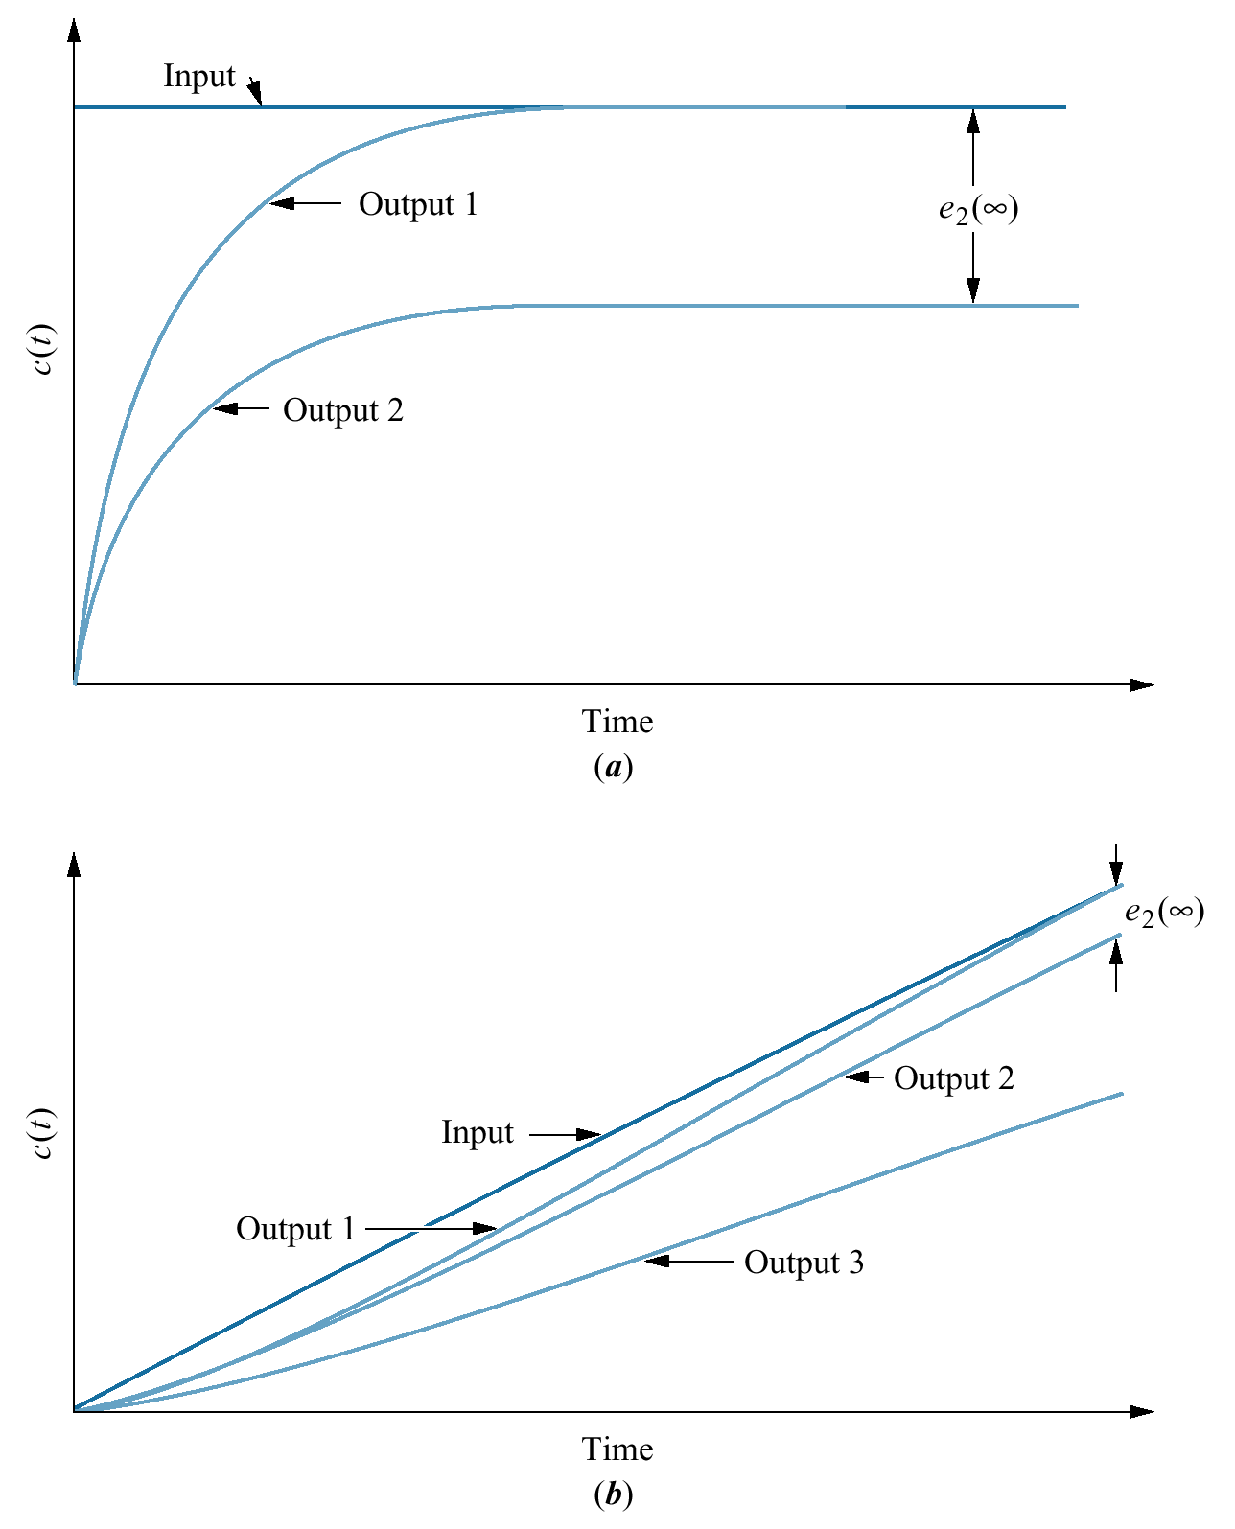
Steady-state error: (step input)

Slide 8
Steady-state error: (ramp input)

Slide 9
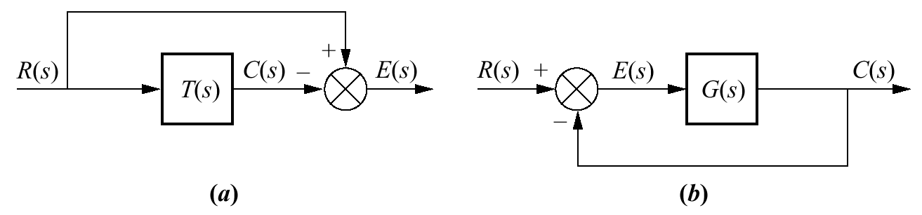
Closed-loop control system error
a. General representation
b. Representation for
unity feedback systems

Slide 10
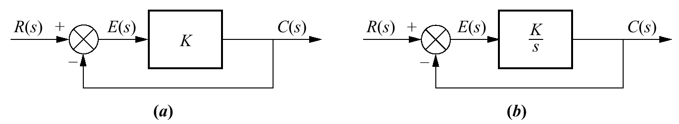
a. System with finite steady-state error for a step input
b. System with zero steady-state error for step input
E(s) = R(s) — C(s) is the error.
For step input, in the steady state, if c(t) equals r(t), e(t) will be zero.
With a pure gain, K, the error, e(t), cannot be zero if c(t) is to be finite and nonzero
E(s)_{ss} =1/K C(s)_{ss}

Slide 11
Steady-State Error for Unity
Feedback Systems

Slide 12



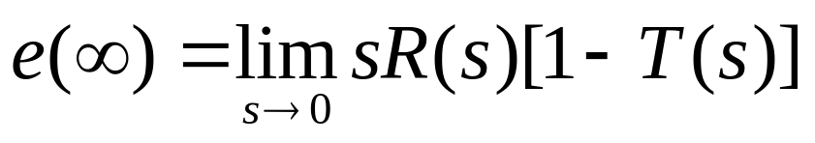
Final and initial value theorem
Steady-State Error in Terms of T(s)

Slide 13

Example 7.1
PROBLEM:
Find the steady-state error for the system shown in the Figure if T(s) = 5/(s² + 7s + 10) and the input is a unit step.
SOLUTION:
From the problem statement,
R(s) = 1/s and
T(s) = 5/(s² + 7s +10)
Applying final value theorem
Substituting E(s) and R(s) into
the following equation:
We get

Slide 14


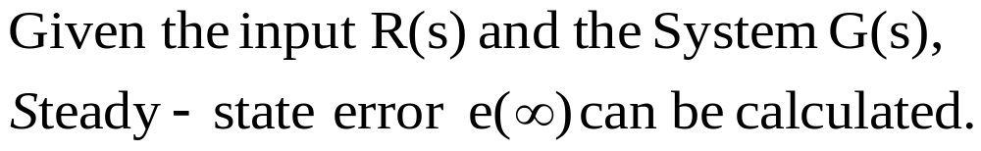

Steady-State Error in Terms of G(s)
System may be configured as unity feedback system with forward transfer function G(s)
Steady-state error may be expressed in terms of G(s) rather than T(s)
To apply the final value theorem, the close loop system must be stable

Slide 15


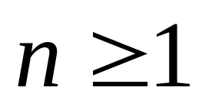



Effect of various inputs on the steady-state error
Step Input
R(s) = 1/s
For the limit to be infinite, the den must equl zero as s goes to zero
The term
is dc gain of G(s)
At least one pure integration must be present in the forward path
For zero steady-state error
If no integrator --- n=0
Finite error

Slide 16



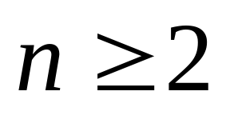
Ramp Input
R(s) = 1/s2
If one integrator --- n=1
For the limit to be infinite, the den must equl zero as s goes to zero
Finite error
If no integrator --- n=0
0
At least two pure integration must be present in the forward path
infinite error

Slide 17



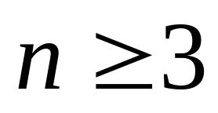
Parabolic Input.
R(s) = 1/s3
If two integrator --- n=2
For the limit to be infinite, the den must equl zero as s goes to zero
Finite error
If one integrator or less --- n<2
0
At least three pure integration must be present in the forward path
infinite error

Slide 18
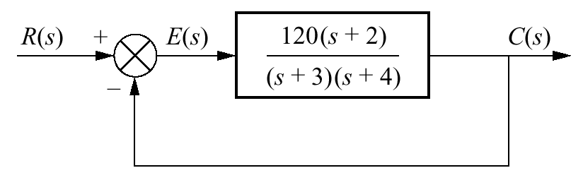



Example 7.2 Steady-State Errors for Systems with No Integrations
PROBLEM: Find the steady-state errors for inputs of 5u(t), 5tu(t), and 5 t² u(t) to the system shown in the Figure . The function u(t) is the unit step.
SOLUTION:
First verify that the closed-loop system is stable.
Next, for the input 5u(t), whose Laplace transform is 5/s, the steady-state error will be five times as large as that given by the Eq for ss error
For the input 5tu(t), whose Laplace transform is 5/s²,
For the input 5t²u(t), whose Laplace transform is 10/s³,

Slide 19
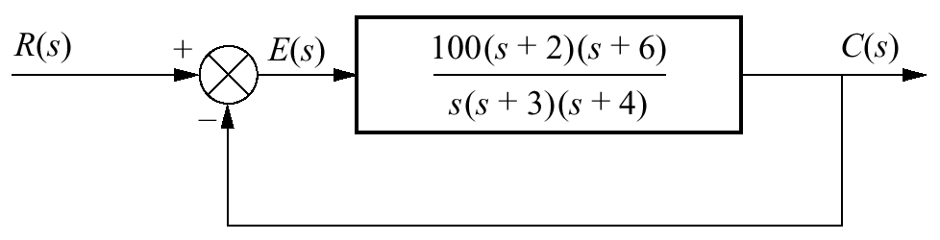


Example 7.3 Steady-State Errors for Systems with One Integration
PROBLEM: Find the steady-state errors for inputs of 5u(t), 5tu(t), and 5 t² u(t) to the system shown in the Figure . The function u(t) is the unit step.
SOLUTION:
First verify that the closed-loop system is stable.
Next, for the input 5u(t), whose Laplace transform is 5/s, the steady-state error will be five times as large as that given by the Eq for ss error
For the input 5tu(t), whose Laplace transform is 5/s²,
For the input 5t²u(t), whose Laplace transform is 10/s³,

Slide 20

???

